Slide 1

How to give
Student Voice Surveys
With Quick Key Mobile for iOS and Android

Slide 2
Introduction
Welcome to our tutorial on how to use Quick Key for your Student Voice Surveys
If you need help with ANYTHING:
Online, look for this icon to chat with us
On your mobile device, click on “Help” and then “Submit a ticket” which will open the chat window

Slide 3

Step 1: Download Quick Key Mobile
On iPhone: search for “Quick Key Mobile”
On iPad or iPod Touch:
Go to Safari and search “Quick Key Mobile App Store”
Or go to the App Store on your device and click “Settings > Show iPhone Apps” then search for Quick Key Mobile
On any Android device’s Google Play Store: search for “Quick Key Mobile”

Slide 4
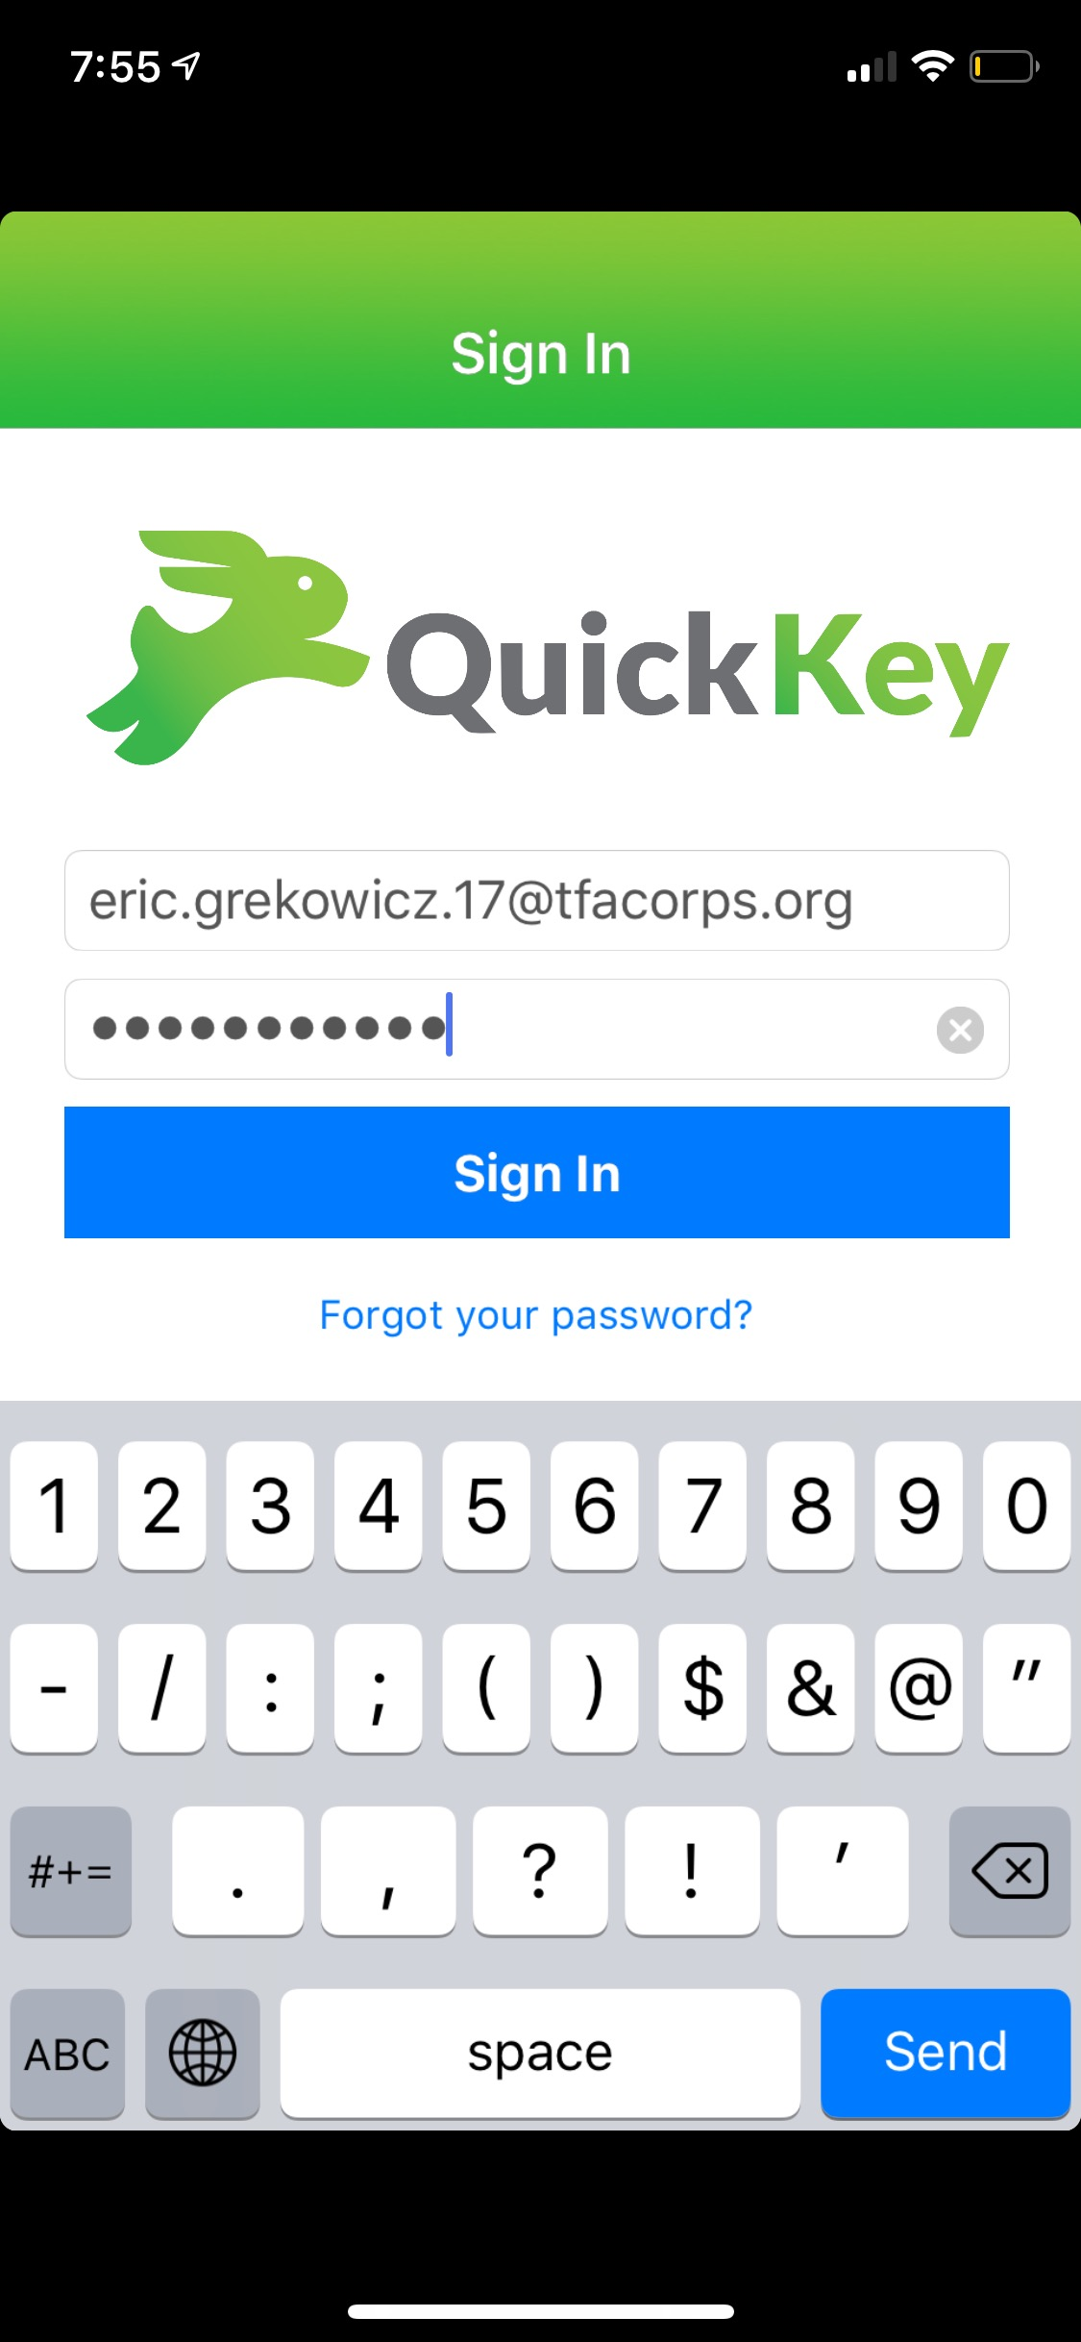
Step 2: Sign in on your mobile device
First, Enter your TFA email address as the username
Second, Enter your password.
If you have never used Quick Key before, your password is “password123”
IF YOU GET AN ERROR:
Your TFA region may have provided your personal email address to Quick Key. Try
using your personal email address.
If you still can not login, go to www.quickkeyapp.com and press the green icon in the
Bottom right corner of the web page. This will open a real-time chat window and we can find
Your login for you. Or you can email us for help at info@quickkeyapp.com

Slide 5
Step 3: Print your Surveys
Your TFA Coach or MTLD will have provided you with a printable copy of your survey
Didn’t get a copy of the survey?
Email us at info@quickkeyapp.com and we will work with your coach to get it to you.
Doing your surveys on Chromebook?
Email us at info@quickkeyapp.com and we will give you instructions on how to give the survey on Chromebook.

Slide 6
Step 4: Print Bubble Sheets & Scan
Print the bubble sheets here.
Or here: https://drive.google.com/file/d/1x01pRHuY3ChDnagOrM8JPoYW8BzS3vno/view
Scan the completed sheets with Quick Key Mobile
Go to the Home Screen of Quick Key Mobile
Go to “Quizzes” and Choose the correct survey from your list of available Quizzes.
  The correct survey contains the current semester and year (e.g. SPR-19)
Select which Course you want to scan for. Your account has six (6) pre-made Survey Courses to allow you to separate your surveys by Class.
Select “Use Student IDs” … This will save your results to the device.
Scan the completed bubble sheets one at a time by aiming the device camera at the sheet. Here’s a video tutorial: https://youtu.be/JJSKPi4GEj8

Slide 7
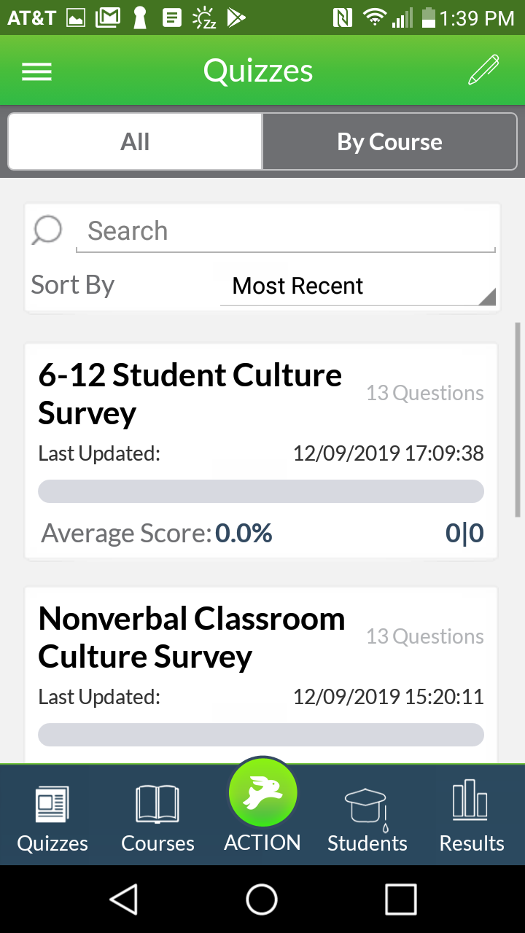
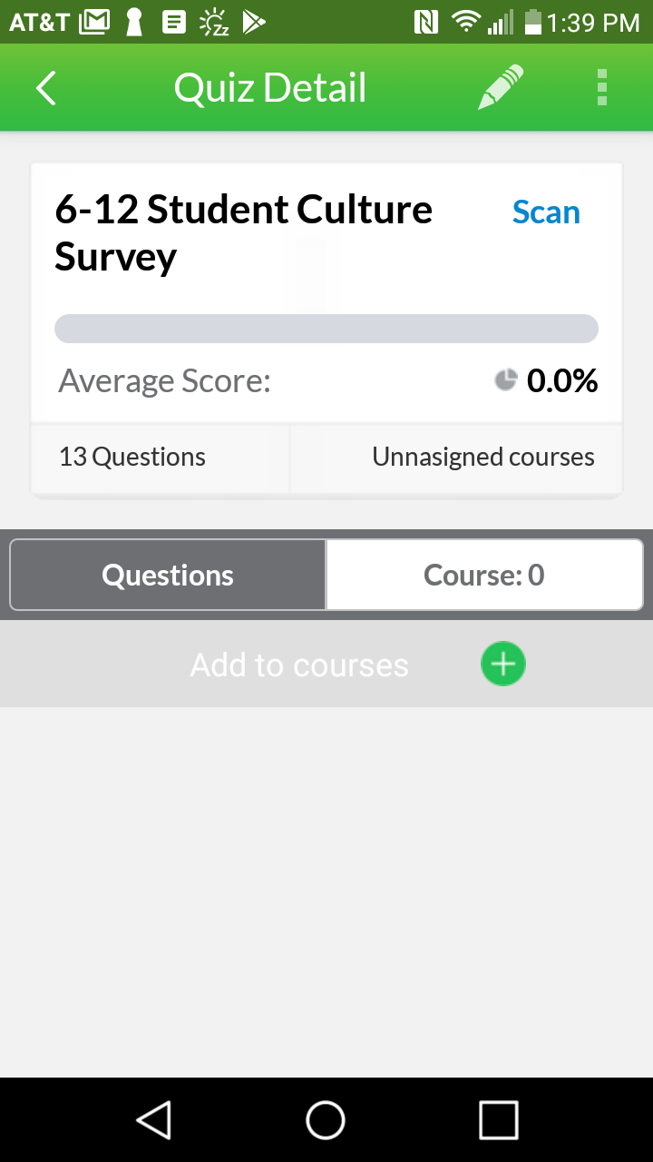
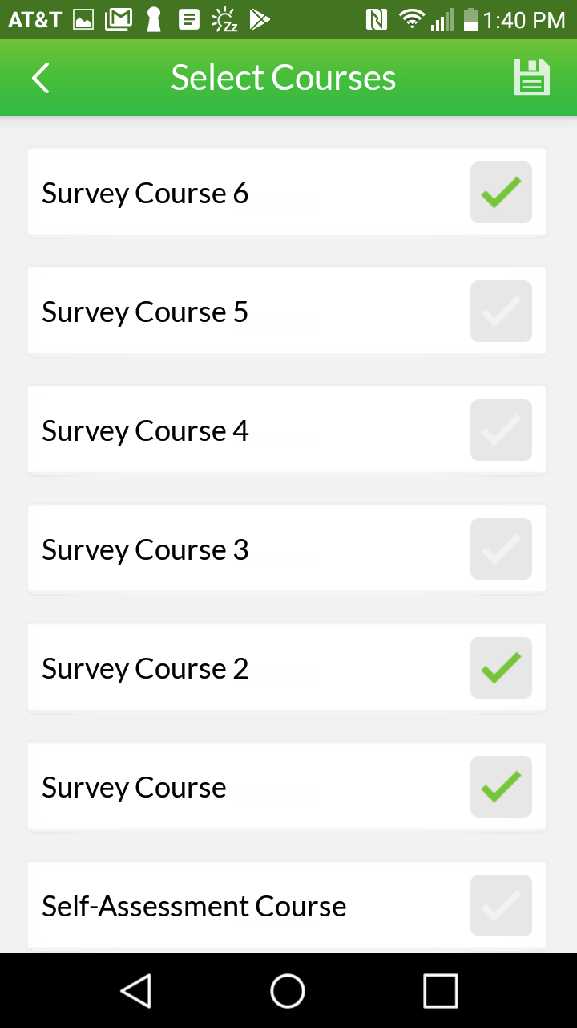
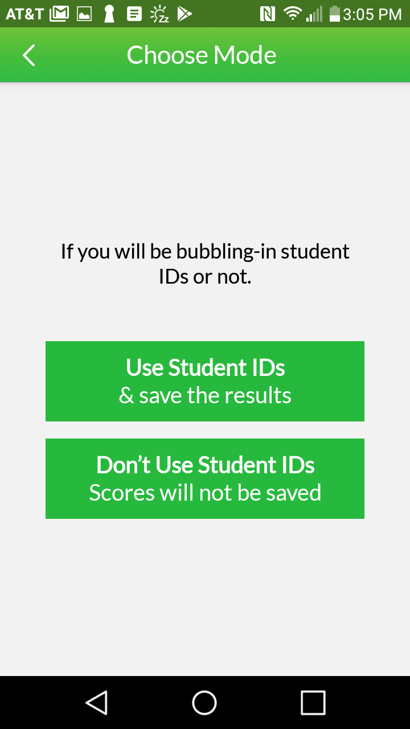
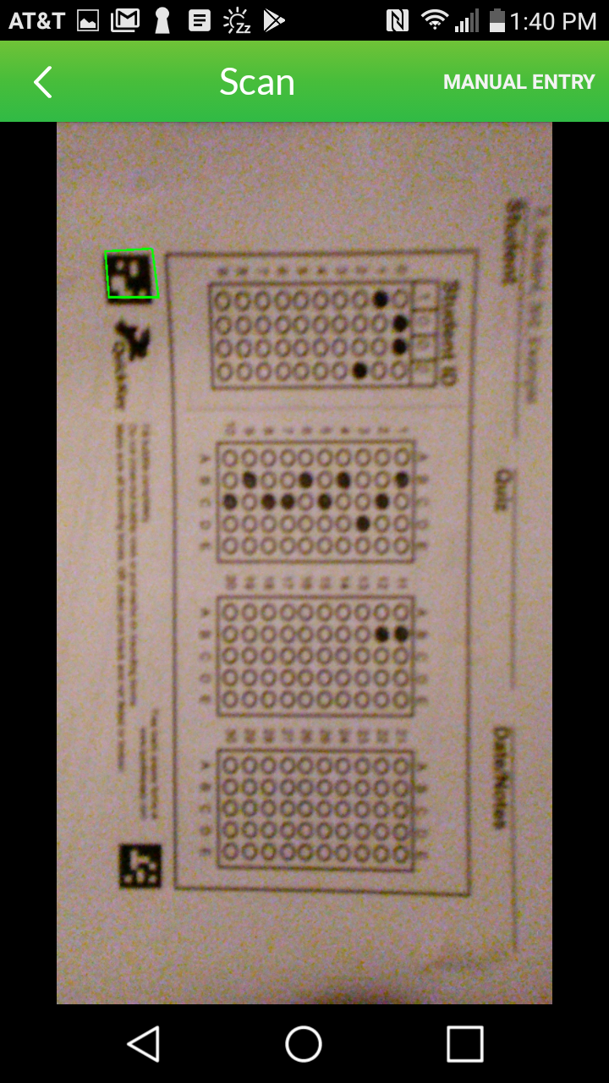
Step 5: Select your survey & scan it
Scan the completed sheets with Quick Key Mobile
Here’s a video tutorial: https://youtu.be/JJSKPi4GEj8
Scan:
Align image with green boxes
Click “Quizzes”
& choose your survey
Click “Course”
Choose the Courses & click the disc icon to save
Click “Scan”
Click “Use Student IDs”

Slide 8
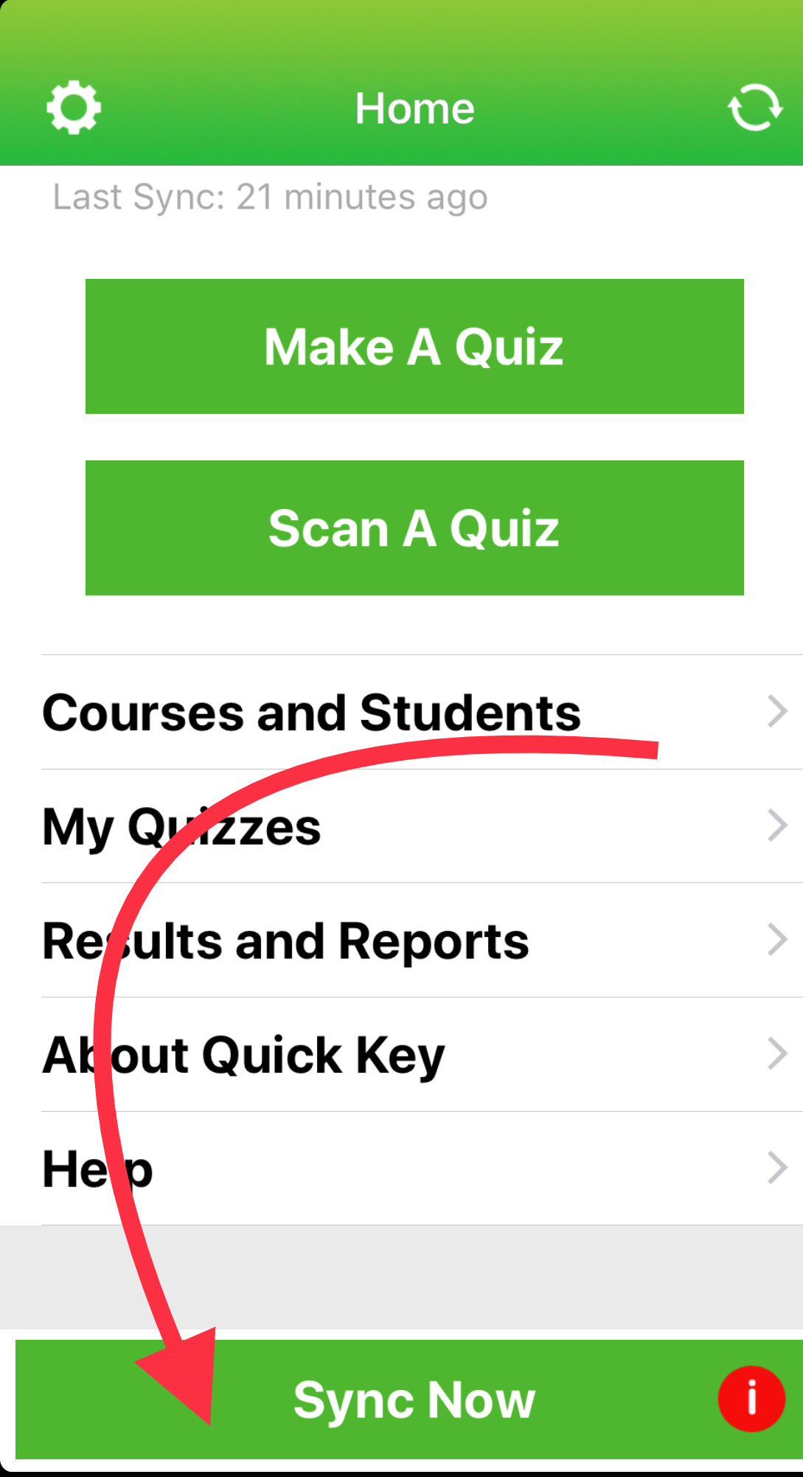
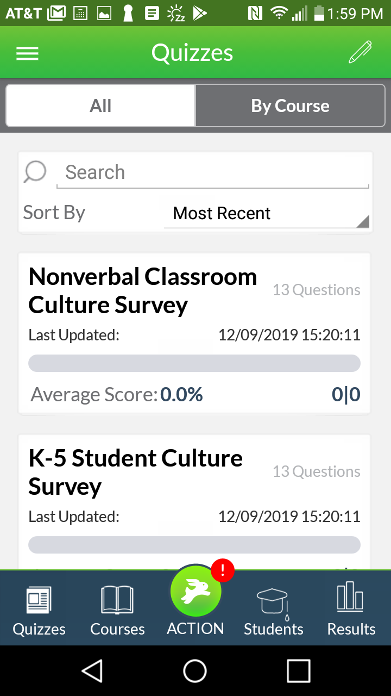
Step 5: Sync your Data to the Cloud
iOS
Android
When you are finished scanning a set of bubble sheets, be sure to sync your data to the Cloud.
iOS:
Press the “Sync” button at the bottom of the screen.
Android:
Press the Rabbit icon at the bottom of the Home screen, then press “Sync”

Slide 9
Last Step: Run a Report
Login at www.quickkeyapp.com
Click “Reports” in the left sidebar menu
Click “Run Report”
In the “Quiz” drop-down, Choose the name of the survey you just did
In the “Report” drop-down, Choose “TFA Teacher Report”
Click “Run”

Slide 10
FAQ
Q: Why does “SCORE IS 0.0” display on my mobile app screen after I scan a sheet?
A: Quick Key was originally built to grade Quizzes. You can ignore this message.
Q: Why does it say “scanner found blanks” after I scanned a sheet?
A: Sometimes the scanner can not read a mark. Click “repair blanks” to fix them.
Q: When I open my report I don’t see my survey results on the survey course tab.
A: Sync the data from your mobile device, then run a new Report.

Slide 11
Well done!
You have now given your Student Voice Surveys and shared the results with your coach. ☺
NEED HELP?
Chat with us in the mobile app, online, or at info@quickkeyapp.com

